Slide 1
College Football
By JAKE BERGEN

Slide 2
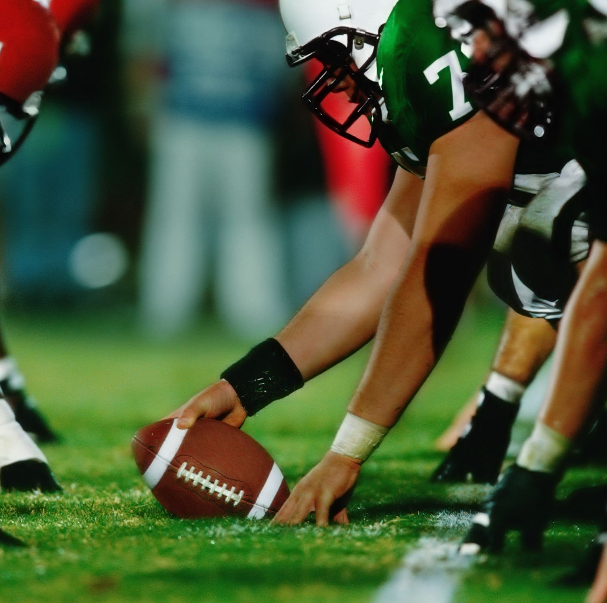
Overview
What makes college football teams win?
Why is offense import?
Is offense all that’s important?
Are there any teams that win differently?

Slide 3
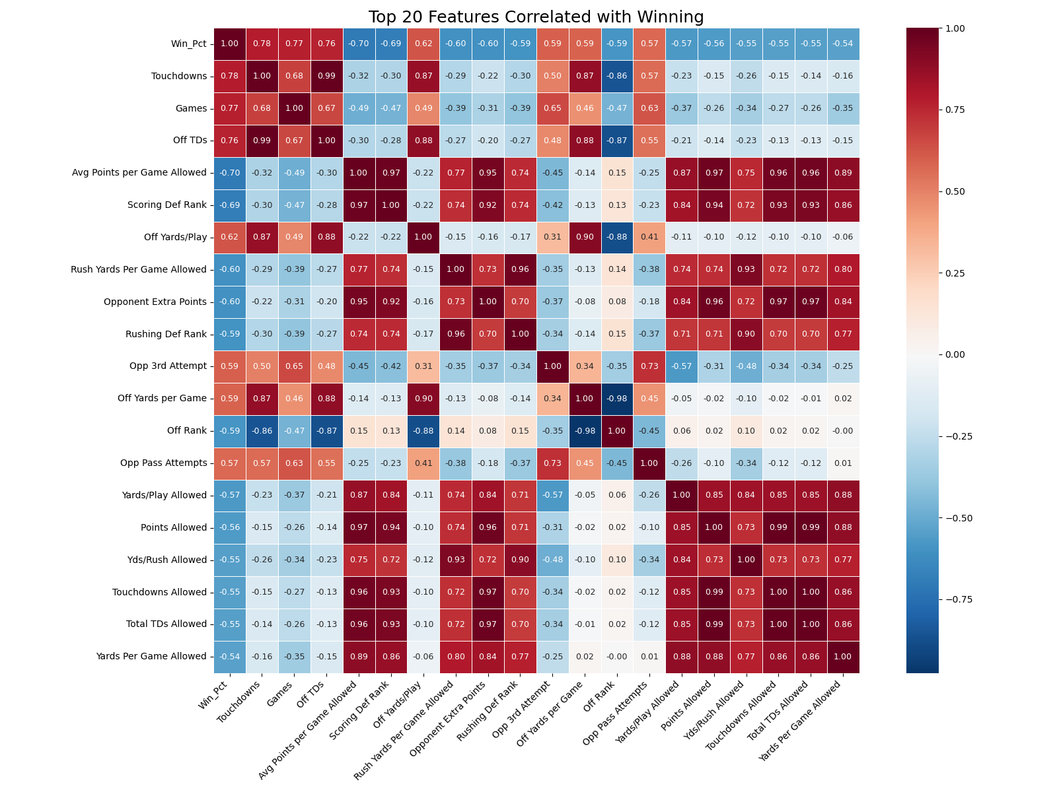

Slide 4
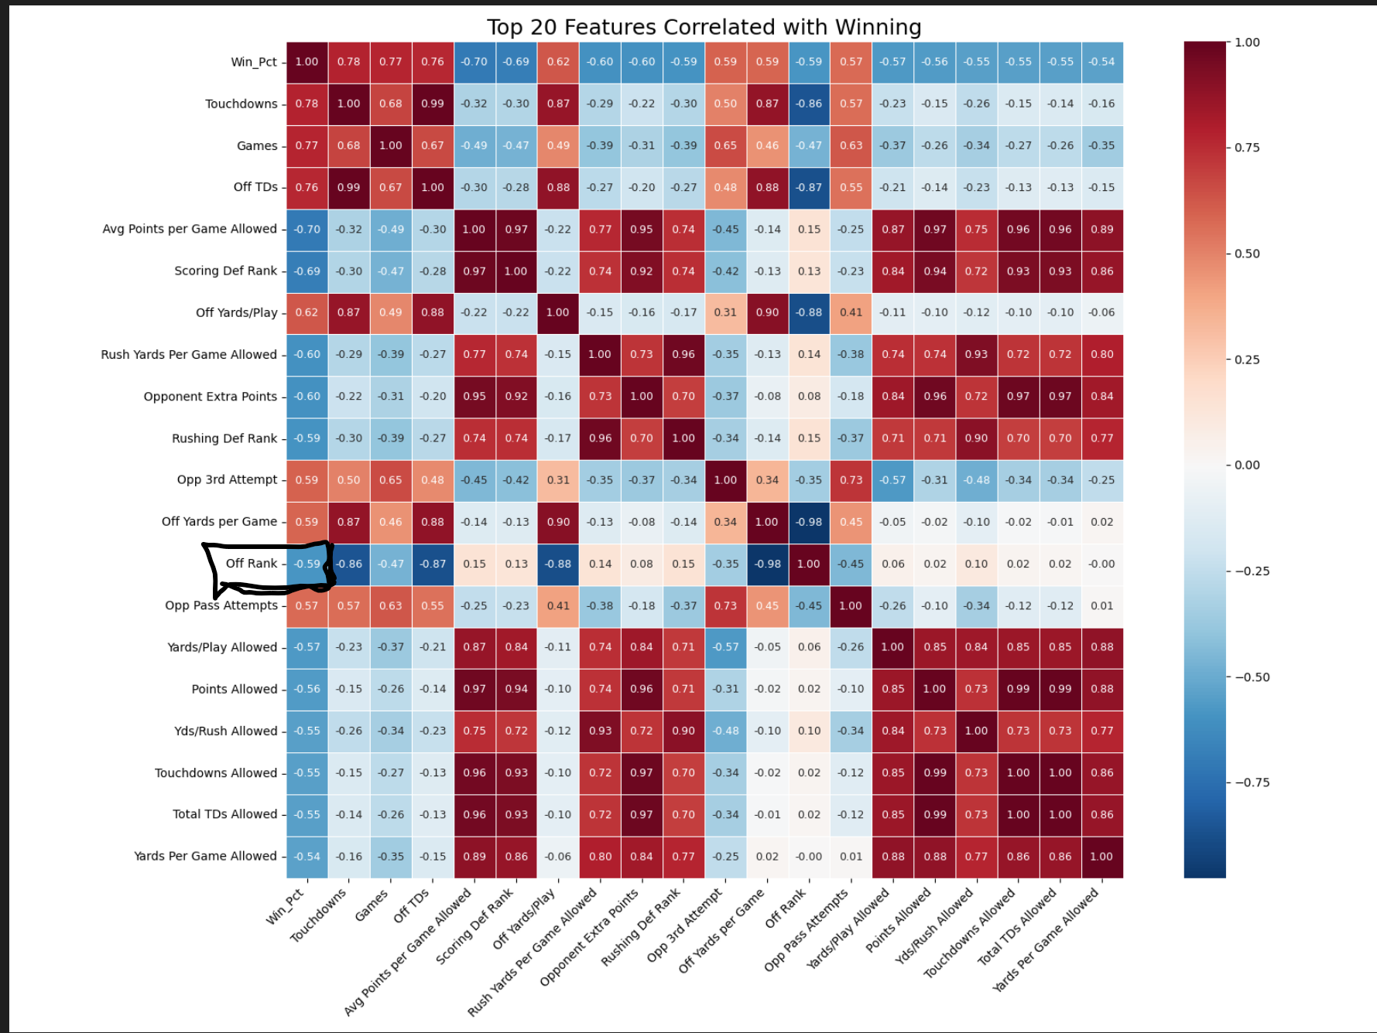

Slide 5
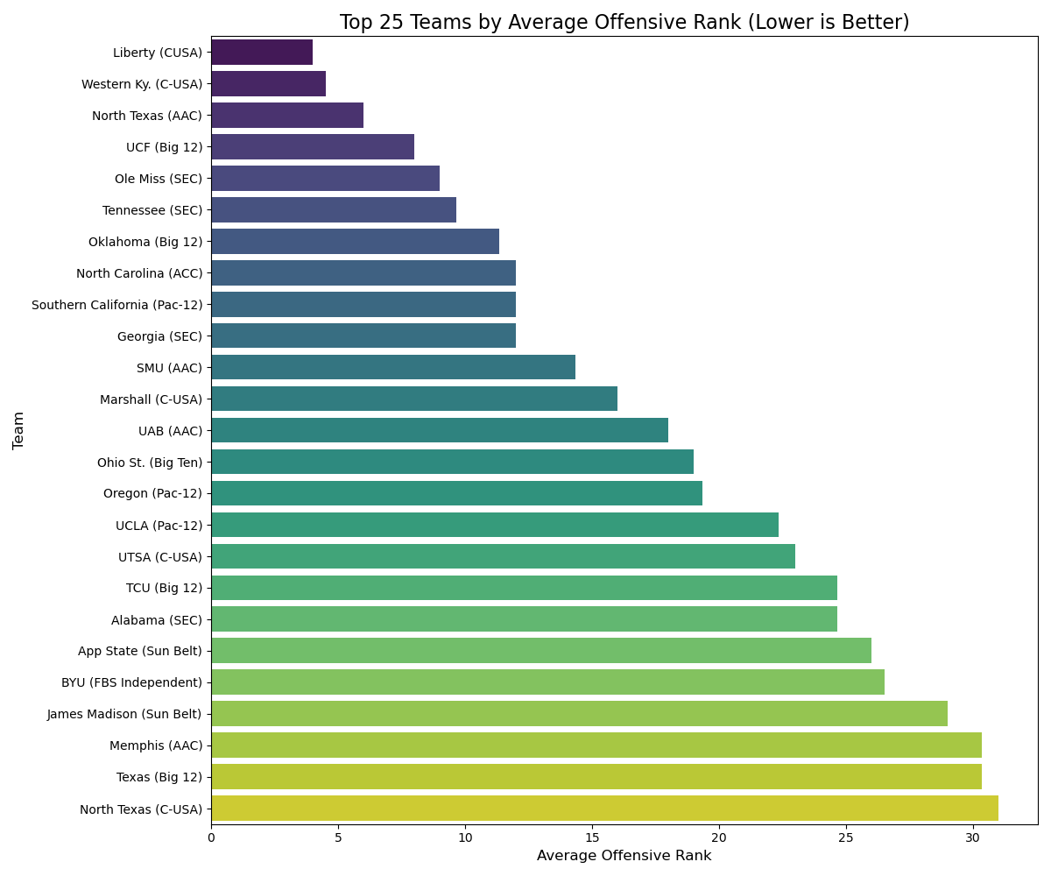
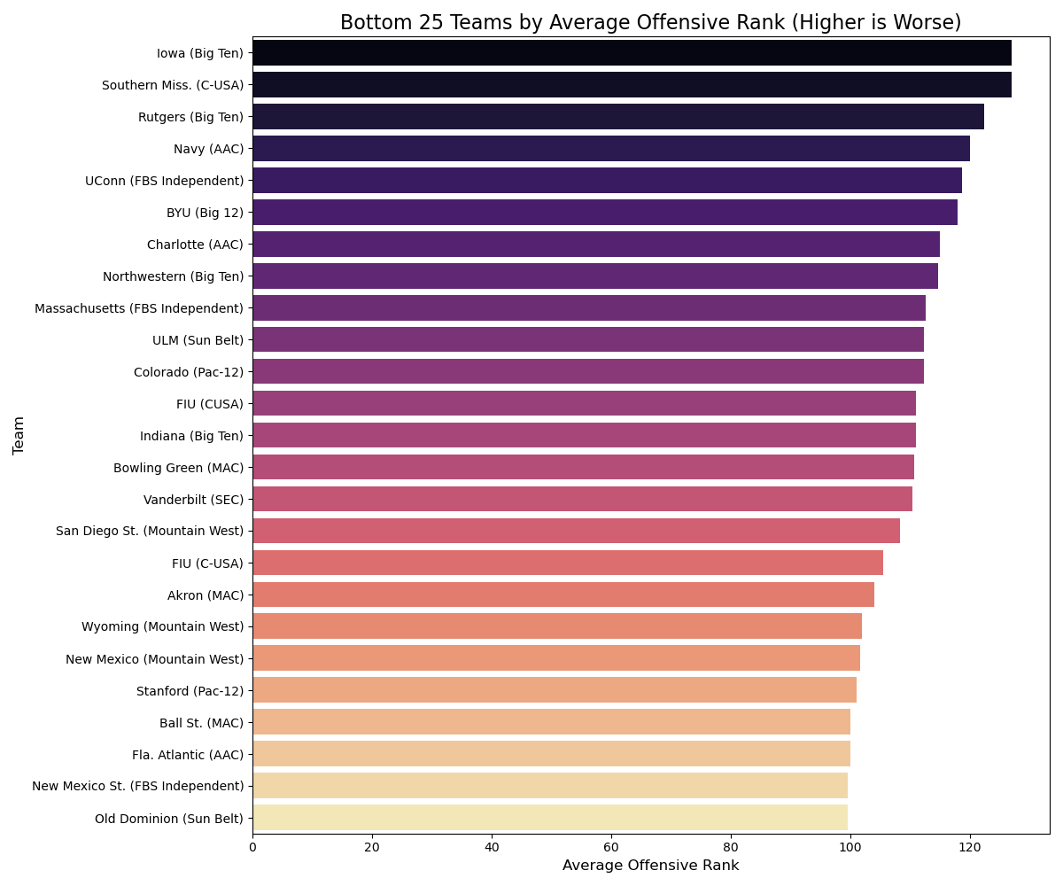
Offensive Statistics

Slide 6


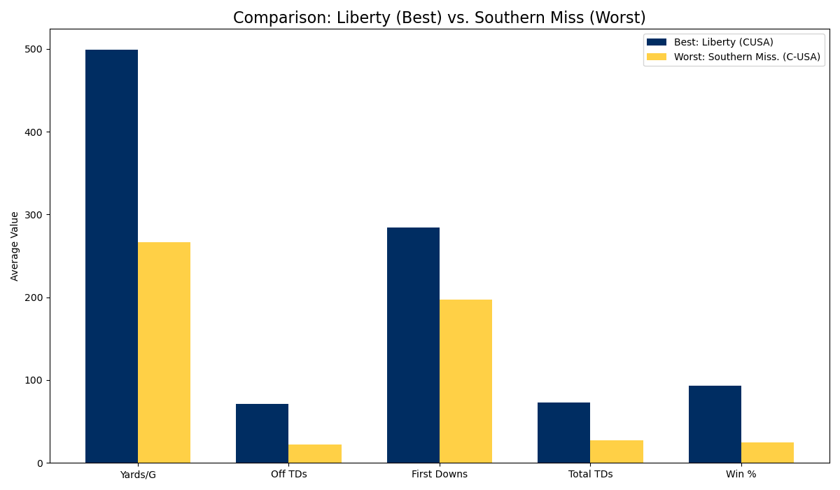
Best VS Worst Offense

Slide 7
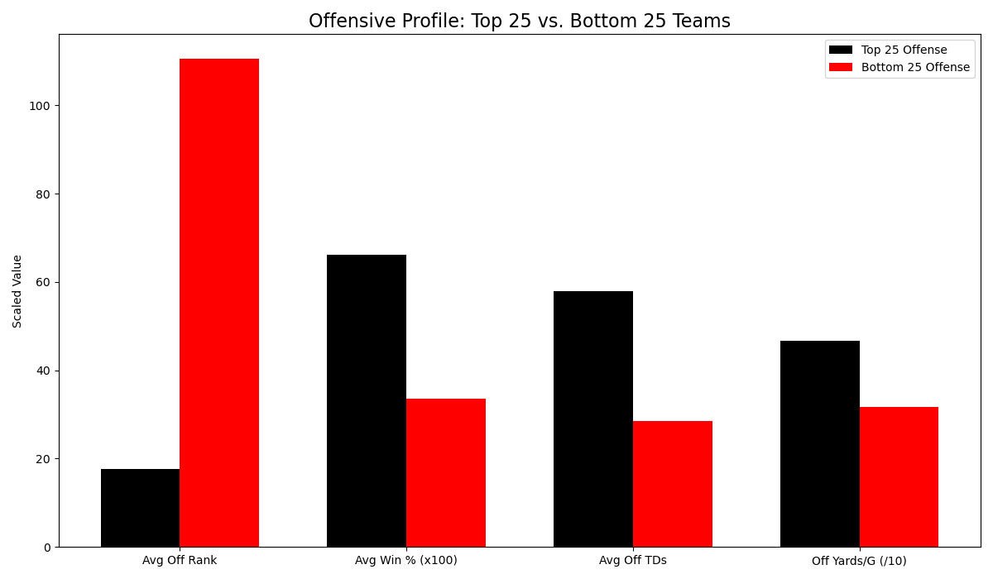
How to be better offensively

Slide 8

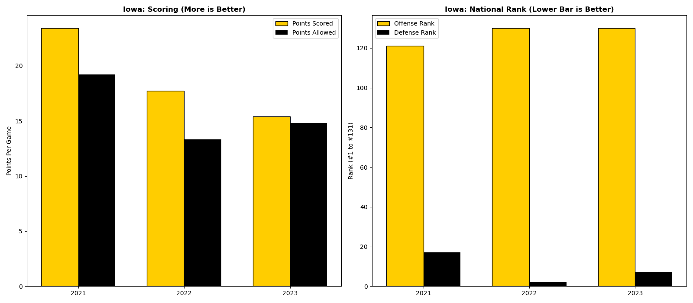
IOWA

Slide 9
WIN PERCENTAGE
Median Win Percentage is 52.09%
Iowa’s is 68.1%

Slide 10

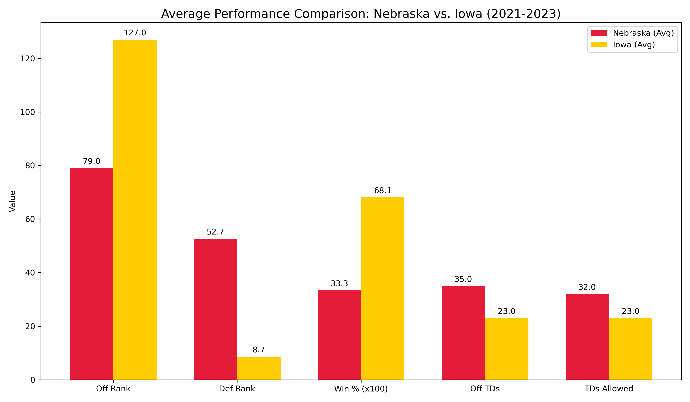
Iowa vs Nebraska

Slide 11
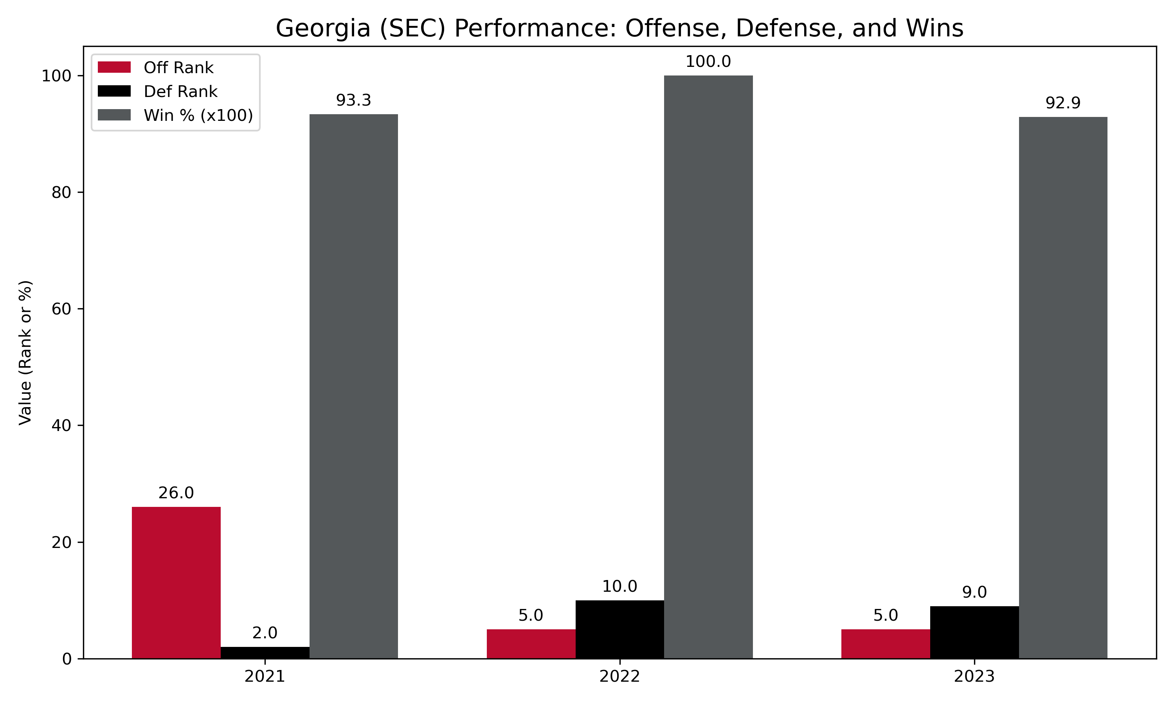

Slide 12
Questions?

